Slide 1
Assignment: Part II

Slide 2
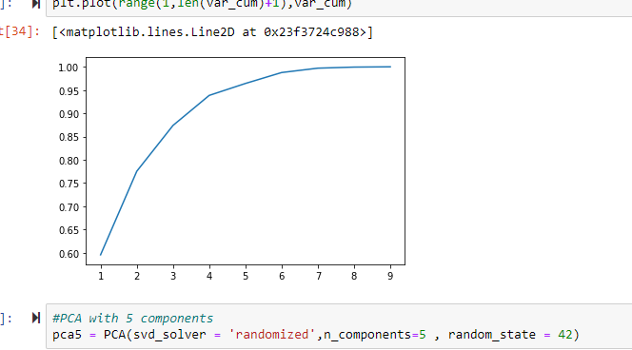
Summary
As CEO of the HELP International NGO needs to decide how to use $ 10 million money strategically and effectively.
There are 167 Countries out of which NGO Needs to know the Countries which are Not doing well in terms of Health and Growth (GDPP) also which has high Child_Mort rate so that the NGO can fund these countries which are in the dearest need of aid and help.
The first step included loading the countries and analyzing missing values, outliers , data format
There are 9 Columns and 167 countries rows in the countries.csv
There is no missing values identified
exports , imports and health is in % of GDPP hence needs to be converted to numbers.
Salary , inflation and GDPP has outliers hence caped them.
Once data is clean, the next step is to apply PCA. :
Scaled the Data to normalize via StandardScaler().fit_transform.
identified PCA Components for 9 colums and their importance by explained_variance_ratio_.
After drawing cumulative barchart, identified that 95% of data is been explained by 5 components
PC1 ,PC2 , PC3, PC4 , PC5
Created the dataframe and merged the countries to these PC components for further Clustering. df_Cont_model
Caped the outliers present for PC1 , PC2 ,PC3 , PC5

Slide 3
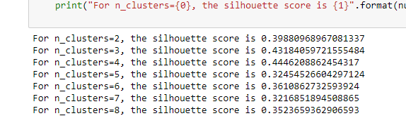
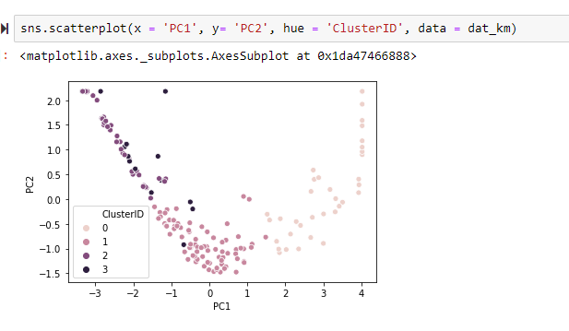
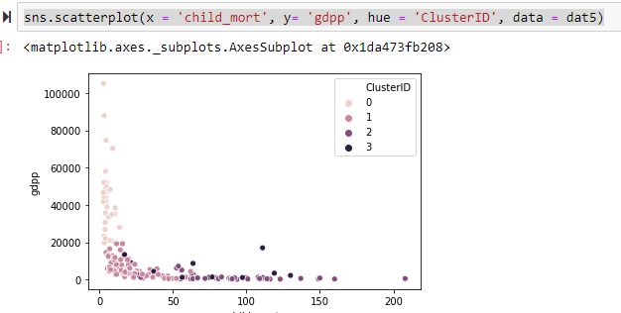
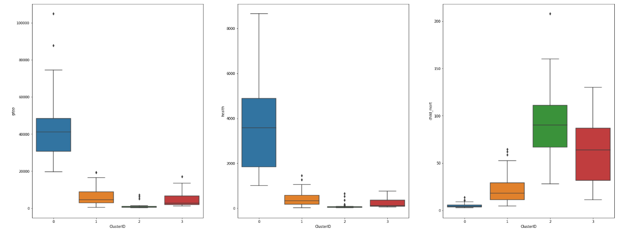
Summary
Applied Hopkins Algo and identified the dataset created is good for Clustering with the score : 82.5%
Identified Silhouette score for Optimal value of K. Took K=4
After applying the Kmeans Algo countries got grouped in 4 clusters.

Slide 4
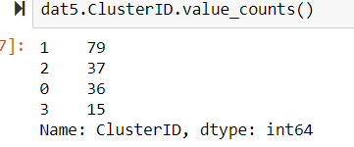
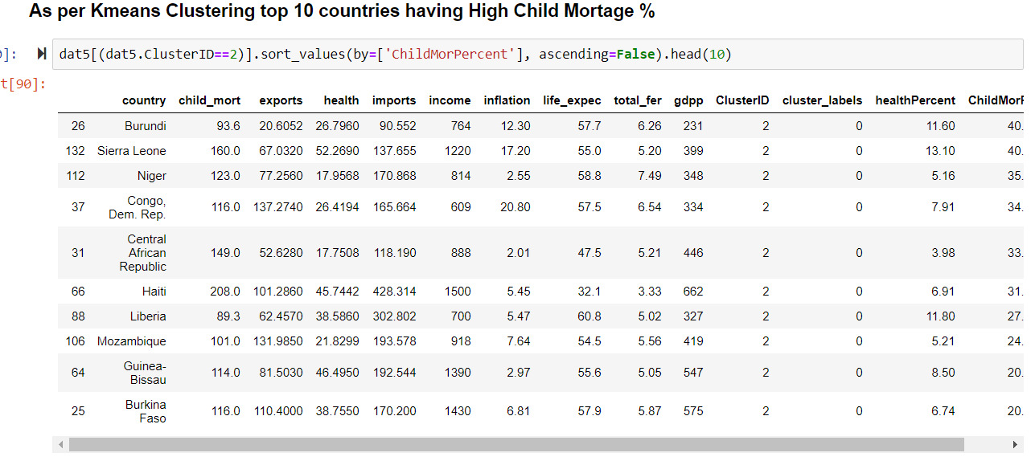
Summary
From the Boxplot it is understood that :
Cluster 2 (37 Countries) is having low GDPP , Health spend and high Child Mort. Hence the countries associated with them are very much in need.
Contries in Cluster 0 (Count - 15) have high GDPP,health and Low Child Mort hence don’t need any help.
Contries in cluster 3 has low GDPP , health and high child Mort after Cluster 2. hence can be considered as per the budget
Calculating the %health and Child_mort% Over GDPP and listing the countries having high low health% and high child_mort% lists Top contries in need and should be focused by NGO
dat5['healthPercent']=dat5['health']*100/dat5['gdpp’]
dat5['ChildMorPercent']=dat5['child_mort']*100/dat5['gdpp']

Slide 5
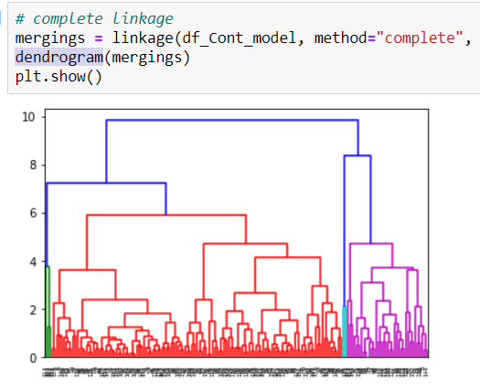
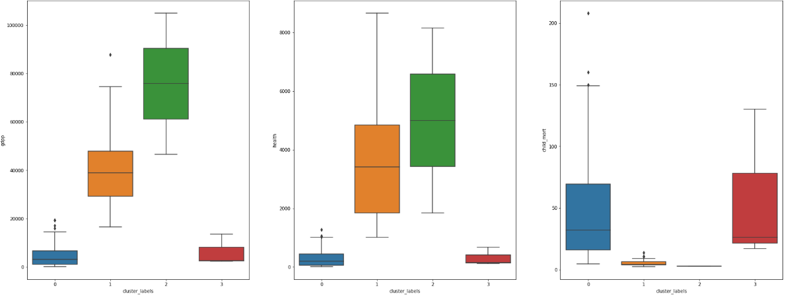
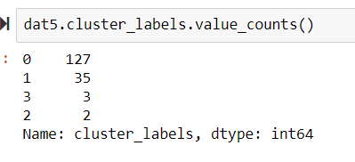
Summary
After Applying Kmeans clustering, applied Hierarchal Clustering algorithm to regroup the data and analyze the countries growth and health factors.
On the PCA applied dataset, performed the linkage and created the dendrogram to identify the ideal clusters. Cutting the graph at 75% gives 4 clusters.
Applied cut_tree function and reshaped the dataframe to map the labels with countries. Created the box plot to visualize the the clusters :
From the above box plot it is clear that cluster 0 and 2 has high child_Mort and Low GDPP/Health numbers. Hence countries in these clusters are in need of

Slide 6
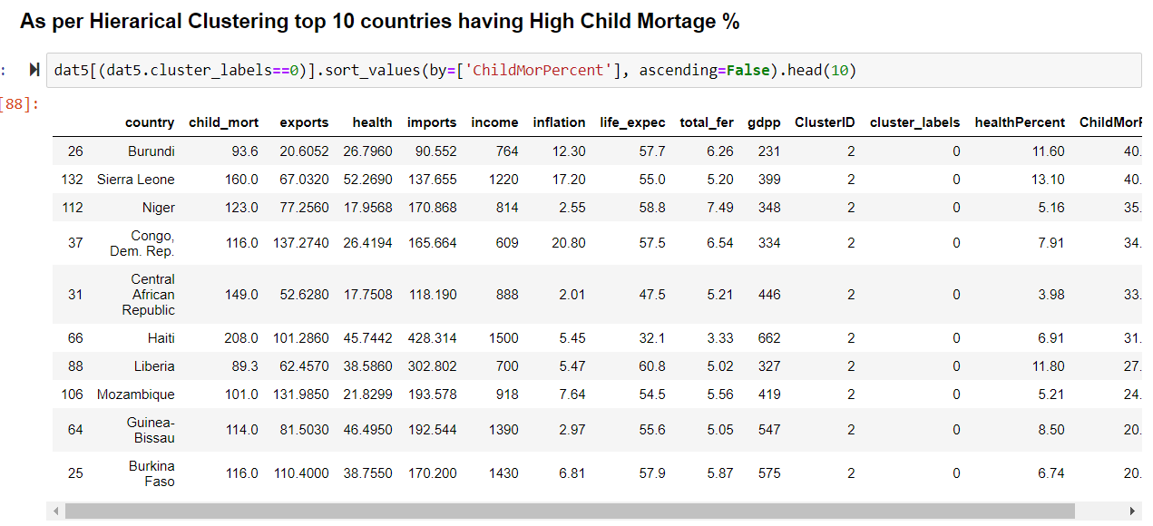
Summary
After sorting countries by child_mort% desc over GDPP, following countries comes up for NGO to focus :

Slide 7
Question 2: Clustering
a) Answer: k means clustering is the process of partitioning a set of data objects into subsets. Each subset is a cluster such that the similarity within the cluster is greater and the similarity between the clusters is less. In Hierarchical methods, we create hierarchical decomposition of the given set of data. We create hierarchical decomposition in two ways such as from bottom to the top or top to down. On the basis how we create hierarchical decomposition we divide this method into two approaches one is agglomerative approach and other is the divisive approach. Kmeans Cluster Hierarchal Clustering
However when sorted the countries as per the Child_mort% both of them gives approximately similar countries in need (Check assignment summary for more details)

Slide 8

Question 2: Clustering
b) Briefly explain the steps of the K-means clustering algorithm. Answer: Clustering has 3 steps : Initialization : Choose random value of K. Silhouette_score can be attached to all the cluster ranges and the K value which has the low K value can be a probable candidates. Cluster Assignment : After identifying k values, the data points that are the closest (similar) to a centroid will create a cluster. If we’re using the Euclidean distance between data points and every centroid, a straight line is drawn between two centroids, then a perpendicular bisector (boundary line) divides this line into two clusters. Move the centroid : New clusters, that need centers. A centroid’s new value is going to be the mean of all the examples in a cluster. We’ll keep repeating step 2 and 3 until the centroids stop moving, in other words, K-means algorithm is converged.

Slide 9
Question 2: Clustering
c) How is the value of ‘k’ chosen in K-means clustering? Explain both the statistical as well as the business aspect of it.|
Answer:
Here we want to find a balance between two variables: the number of clusters (k) and the average variance of the clusters. As the number of clusters increases, the average variance decreases.
There are 167 countries present for NGO to fund. On the basis of Silhouette_score, we can identify the scores of each cluster and choose the one having the low score respectively.
Elbow graph is also useful to identify the numbers of cluster by checking at which cluster maximum data variation is happening.
We choose 4 clusters here to identify countries more closely on Growth and health factors so that NGO can have more clarity and can fund countries which are really in Need of AID

Slide 10
Question 2: Clustering
d) Explain the necessity for scaling/standardisation before performing Clustering.
Answer:
Standardizing data is recommended because otherwise the range of values in each feature will act as a weight when determining how to cluster data, which is typically undesired.
So If the variables are of incomparable units then they should be standardized by scaling. K-clustering is 'isotropic' in all directions, meaning that the clusters tend to be more or less round. By not scaling, we may put weight on certain variables

Slide 11
Question 2: Clustering
e) Explain the different linkages used in Hierarchical Clustering.
Single-Link, Complete-Link & Average-Link Clustering
Hierarchical clustering treats each data point as a singleton cluster, and then successively merges clusters until all points have been merged into a single remaining cluster. A hierarchical clustering is often represented as a dendrogram .
In complete-link (or complete linkage) hierarchical clustering, we merge in each step the two clusters whose merger has the smallest diameter (or: the two clusters with the smallest maximum pairwise distance).
In single-link (or single linkage) hierarchical clustering, we merge in each step the two clusters whose two closest members have the smallest distance (or: the two clusters with the smallest minimum pairwise distance).
Average-Link Clustering is a compromise between the sensitivity of complete-link clustering to outliers and the tendency of single-link clustering to form long chains that do not correspond to the intuitive notion of clusters as compact, spherical objects

Slide 12
Question 3: Principal Component Analysés
a) Give at least three applications of using PCA.
Answer: The primary application of PCA is dimension reduction. If we have high dimensional data, PCA allows us to reduce the dimensionality of data so most of the variation that exists in data across many high dimensions is captured in fewer dimensions. PCA has many usage examples like :
A predictive model setup where there are a lot of features to eliminate
A dataset where we needed to perform EDA and Data Visualization.
Multicollinearity elimination.
Noise Reduction.
finding latent Themes
PCA Can be applied to :
Disease control, especially when you research focus transcends beyond just the investigation to the causes and analysis of one type of disease
Quantitative Finance in evaluating stock portfolio, energy pricing and stock selection for technical trading.
Banking Applications to find valuable customers/defaulters

Slide 13
Question 3: Principal Component Analysis
b) Briefly discuss the 2 important building blocks of PCA - Basis transformation and variance as information.
Basis transformation :The transformation is defined in such a way that the first principal component has the largest possible variance (that is, accounts for as much of the variability in the data as possible), and each succeeding component in turn has the highest variance possible under the constraint that it is orthogonal to the preceding components.
Variance : variance is the expectation of the squared deviation of a random variable from its mean. Informally, it measures how far a set of (random) numbers are spread out from their average value. Variance has a central role in statistics, where some ideas that use it include descriptive statistics, statistical inference, hypothesis testing, goodness of fit, and Monte Carlo sampling. Variance is an important tool in the sciences, where statistical analysis of data is common. The variance is the square of the standard deviation, the second central moment of a distribution, and the covariance of the random variable with itself.
The total variance is the sum of variances of all individual principal components.
The fraction of variance explained by a principal component is the ratio between the variance of that principal component and the total variance.

Slide 14
Question 3: Principal Component Analysis
c) State at least three shortcomings of using Principal Component Analysis. Answer: PCA has some limitation on its usage based on the following assumptions
Linearity : PCA assumes that the principle components are a linear combination of the original features. If this is not true, PCA will not give you sensible results.
Large variance implies more structure : PCA uses variance as the measure of how important a particular dimension is. So, high variance axes are treated as principle components, while low variance axes are treated as noise.
Orthogonality : PCA assumes that the principle components are orthogonal .it's a restriction to find projections with the highest variance:

Slide 15
Thank you

